Slide 1
National U.S.-Arab Chamber of Commerce Internship
By: Karim Edward Zamrini

Slide 2
What I do at the chamber
Database Entry
Contact Research
Media Outreach
Event Assistance
Business Trips

Slide 3
Travel to Washington D.C.
Alongside my work in database entry, I also have been given the opportunity to travel to Washington D.C. and attend business meetings. This gave me great insight into the world of commerce.

Slide 4
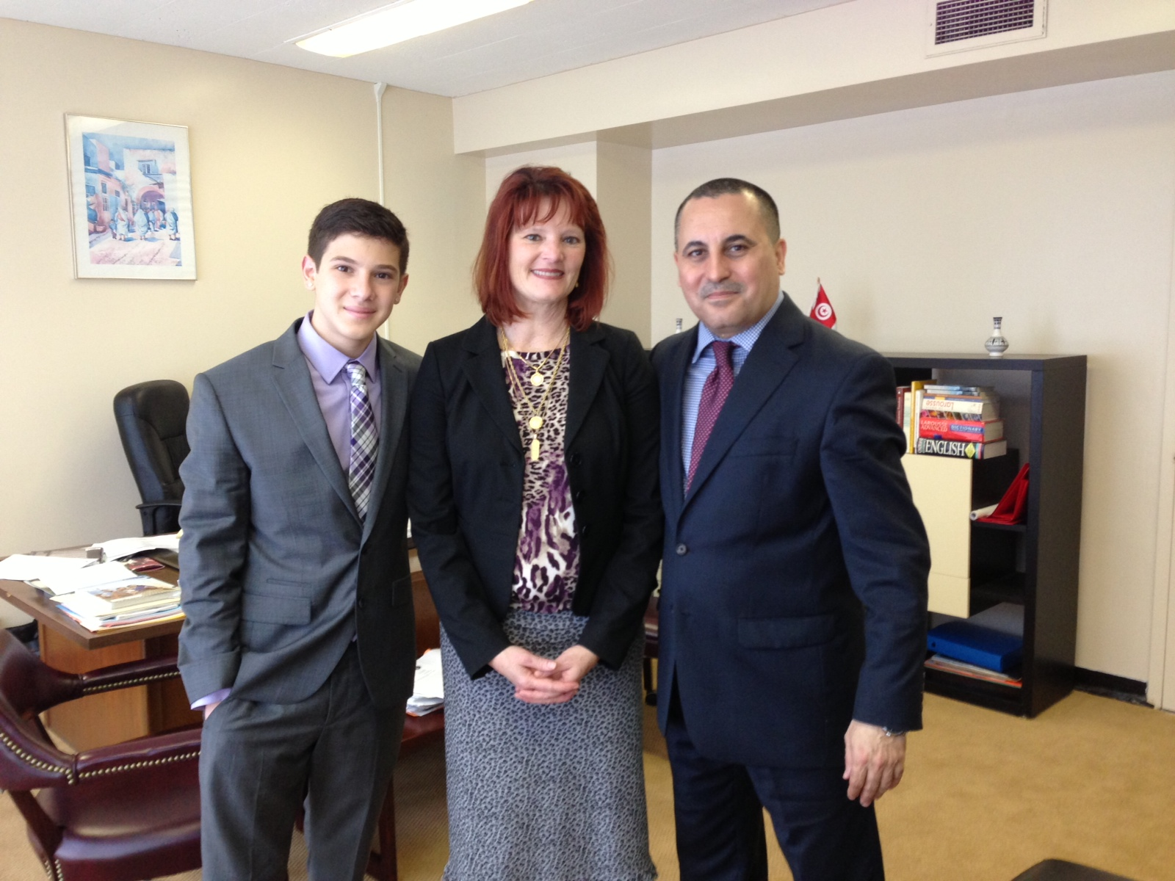
Tunisian Embassy

Slide 5
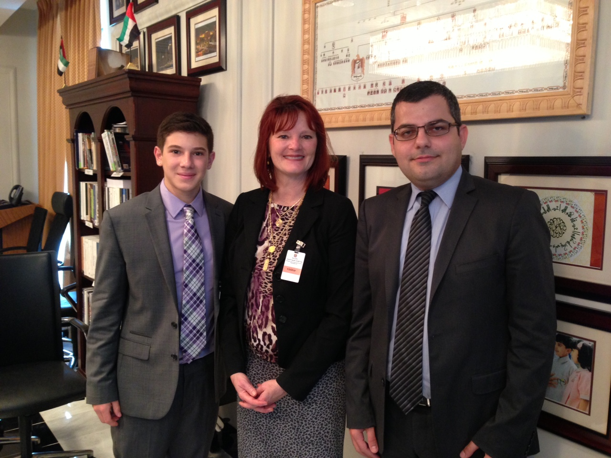
U.A.E. Embassy

Slide 6
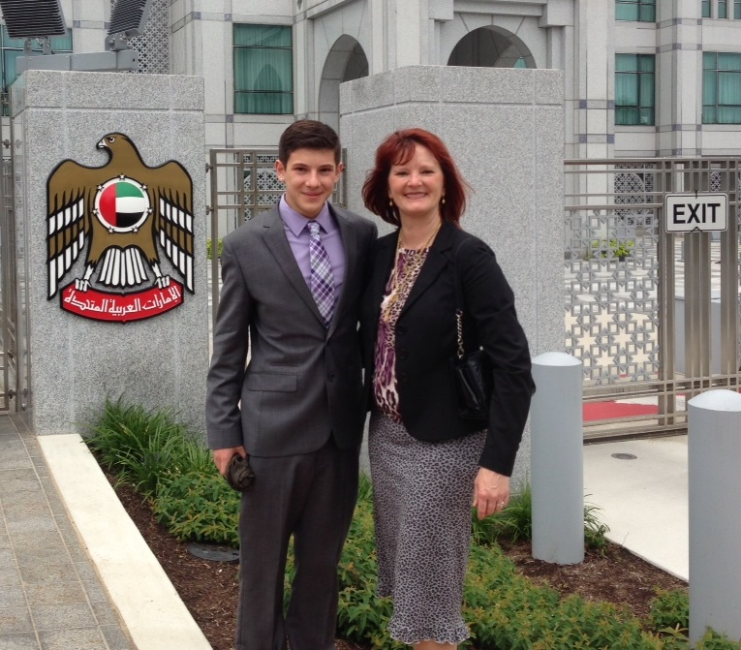
U.A.E. Embassy (Cont.)

Slide 7
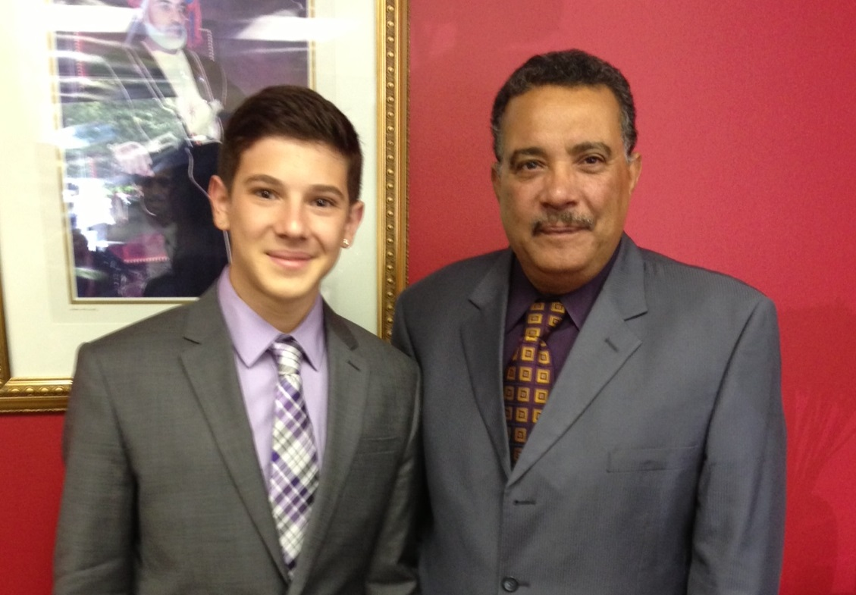
Omani Embassy

Slide 8
Microsoft Excel Work
Much of my work is database entry and formatting of sensitive contacts in Microsoft Excel worksheets. I have learned to:
Conform information into a single format
Contact people about missing information
Find duplicate values and sort lists
Compare lists of thousands of people
Organize files in an easy-to-access manner

Slide 9
Thank You For The Support
Cynthia Douglass – Mentor
The National U.S.-Arab Chamber of Commerce(NUSACC) – my placement organization

